Slide 1
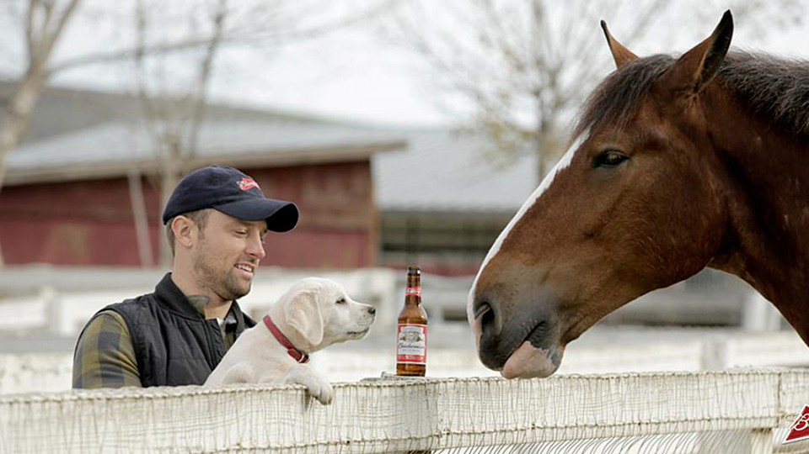
Anheuser-Busch Beer Report 2019 Beer and Brewery Spotlight
Phillip Hale
For additional details on the dataset and findings refer https://github.com/naivelogic/MSDS-6306-Case-Study-01-Budweiser

Slide 2

Objective: Assess the relationship of ABV and IBU
Reviewed over
2,000
Types of Beers
Produced
in
558
Breweries
across
51
States + Washington DC

Slide 3
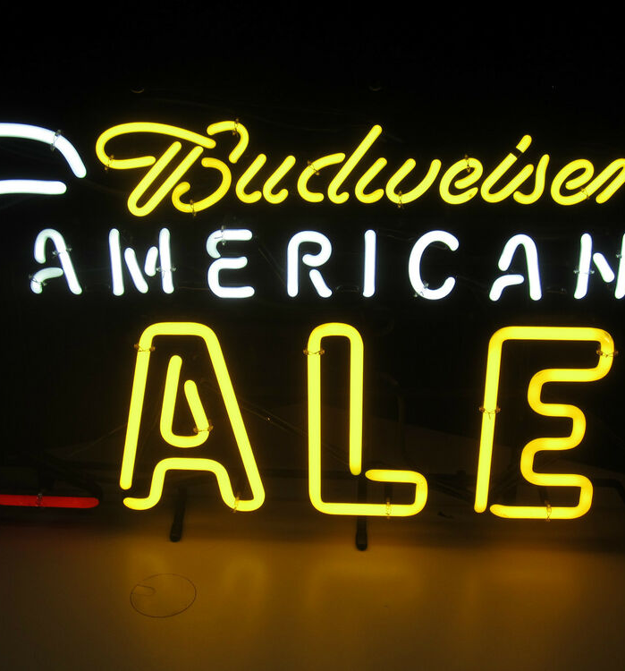

AMERICAN IPA MOST PRODUCED BEER STYLE...
Top 5 beer styles produced in the United States

Slide 4
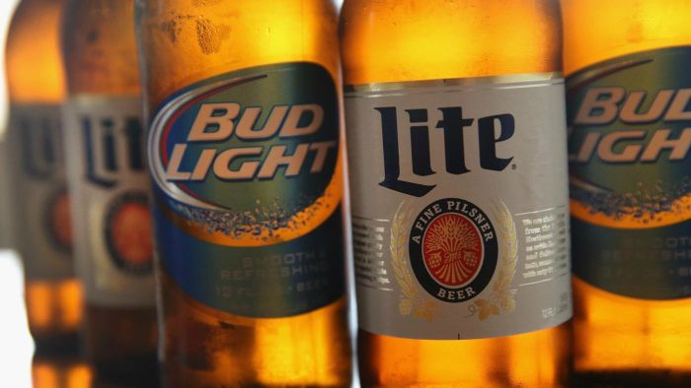
HANDLING MISSING VALUES
3%
ABV Values Missing
43%
IBU Values Missing
South Dakota
Removed From IBU Analysis

Slide 5
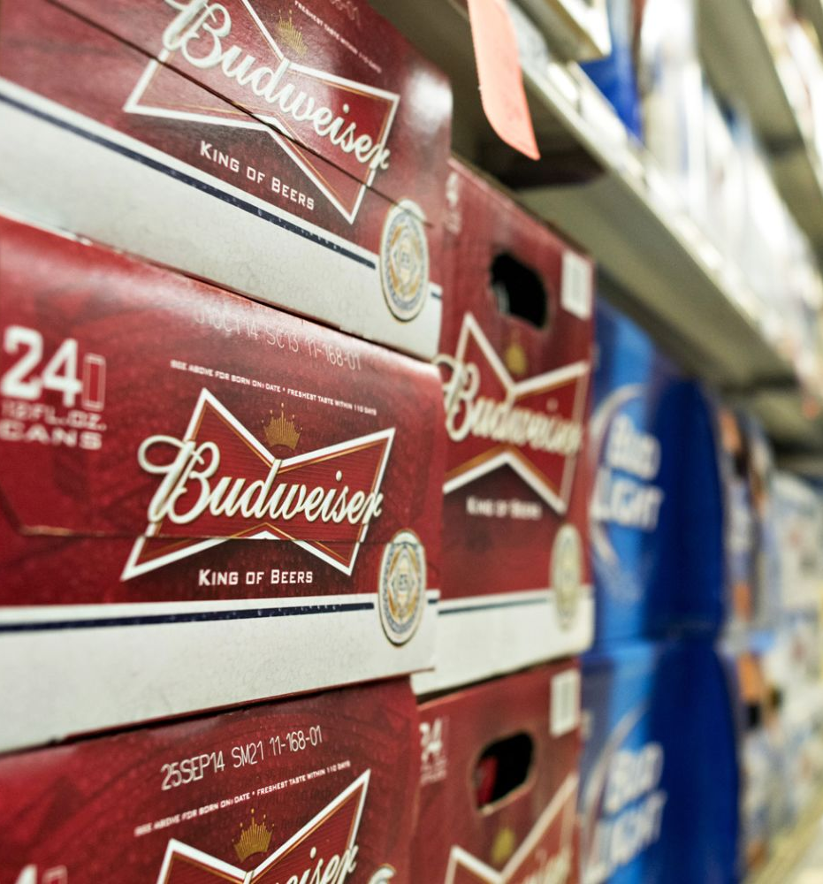
DC & Kentucky PRODUCES THE HIGHEST ABV (ON AVERAGE)...
Top 5 states with this highest median ABV
Refer to appendix for full Median ABV by State Graph
Notes:
Image from https://fm.cnbc.com/applications/cnbc.com/resources/img/editorial/2014/10/30/102138680-458104168.1910x1000.jpg

Slide 6
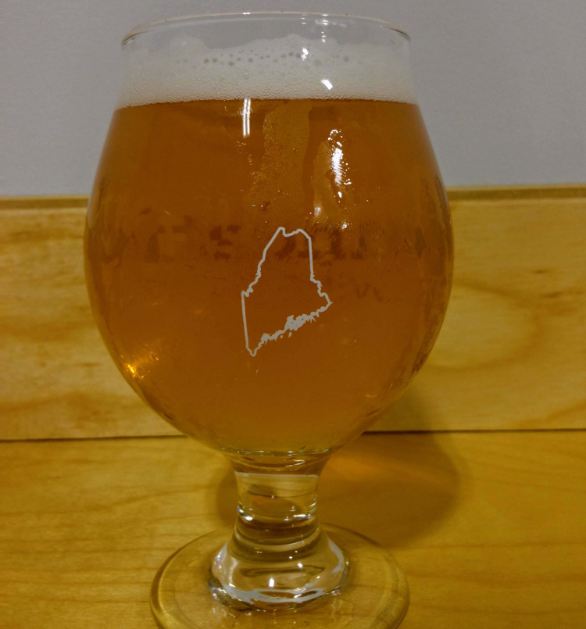
MAINE PRODUCED THE HIGHEST IBU (ON AVERAGE)...
Top 5 states with this highest median IBU
Refer to appendix for full Median IBU by State Graph

Slide 7
...but our opportunity lies In The West.
Median ABV
Median IBU
Refer to appendix for full Median IBU by State Graph

Slide 8
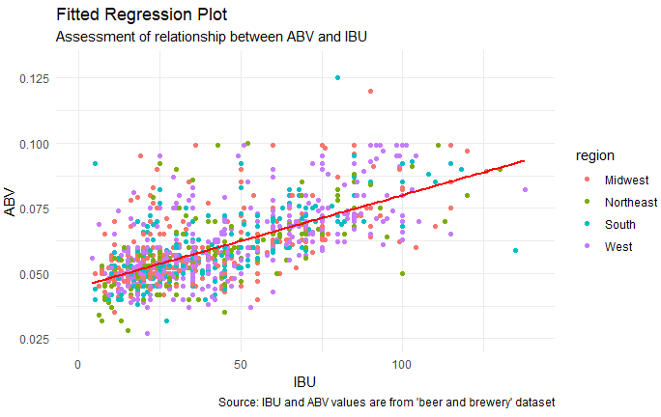
45% of the variation
in ABV is explained
by the amount of IBU
Significant
Relationship
As IBU increases,
So does ABV.

Slide 9
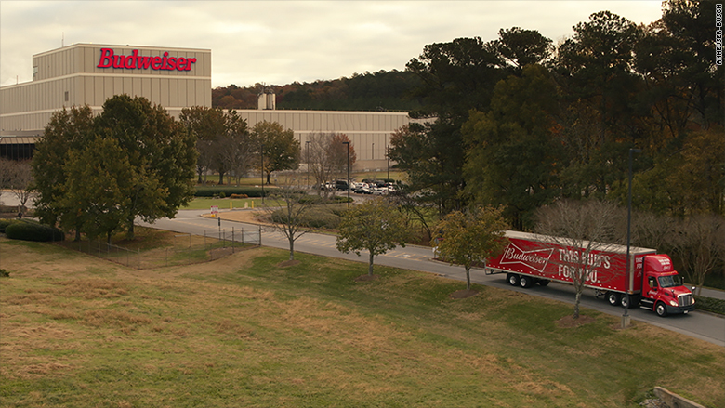
Conclusion
For additional details on the dataset and findings refer https://github.com/naivelogic/MSDS-6306-Case-Study-01-Budweiser
YouTube - Presentation

Slide 10
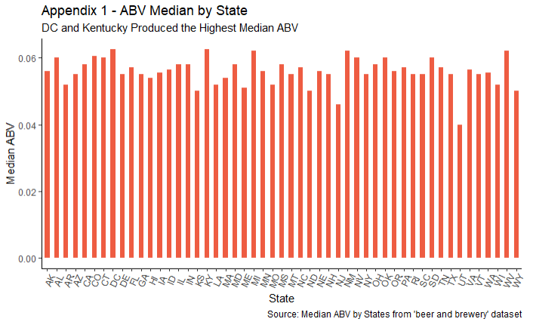

Slide 11
